Slide 1

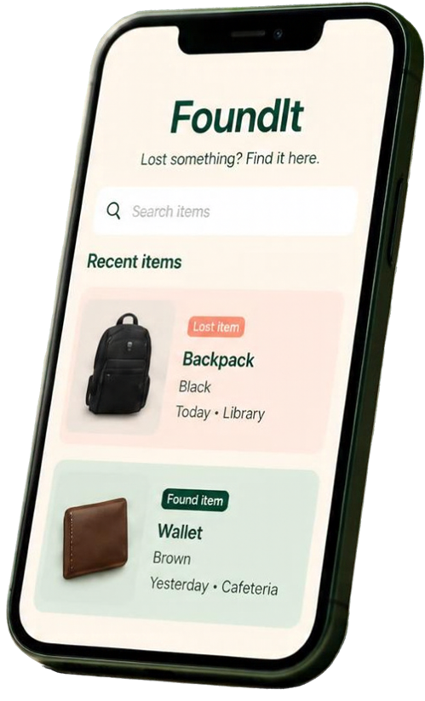


FoundIt
Lost. Found. Reunited.
A smarter way to reconnect people with lost belongings
SIH26219

Slide 2





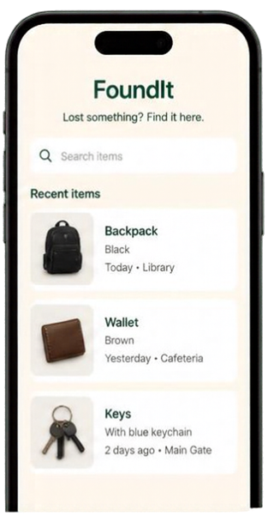

The Problem → Our Solution
FoundIt brings lost-and found into one simple, organized platform.
THE PROBLEM
OUR SOLUTION
Reports are scattered and hard to track.
FoundIt is one place
to post, search, and report.
Simple item details category, description, time, and location
Scattered reports across
notice boards, chats, and offices
Slow communication and follow-up
Everything in one organized platform
Saves time and reduces stress
Hard to find the right information when you need it
Improves chances of reuniting items with owners

Slide 3

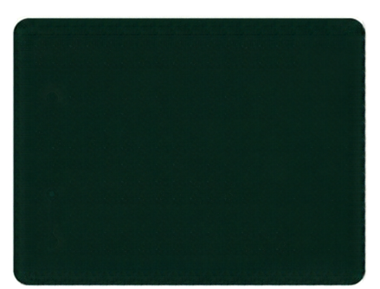
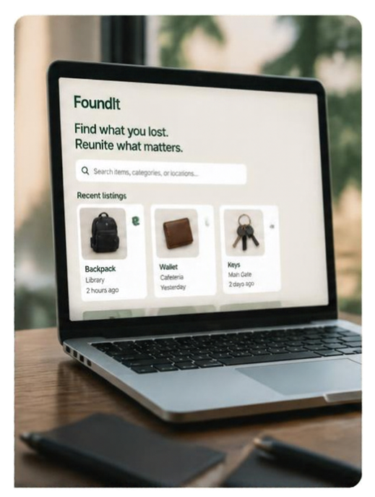


















Smart Features, Built to Scale
Core capabilities today. Scalable architecture for tomorrow.
WHAT USERS GET
BUILT ON A MODERN STACK
Responsive web app
Report and browse items
Clear listings with photos
for lost and found items
API backend
Scalable database
Secure authentication
Search that works
Search items...
Find by category, keywords, and exact location
BUILT FOR WHAT’S NEXT
All
Backpack
Wallet
Keys
AI-powered matching
QR tags for items
Safe and trustworthy
Claim verified
Smart alerts and updates
Verified claims and privacy-conscious contact
Contact shared safely
Location-aware discovery

Slide 4

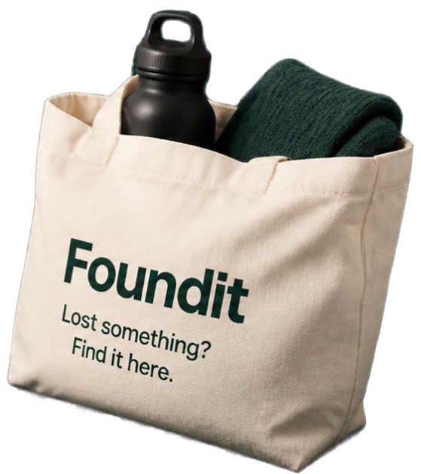







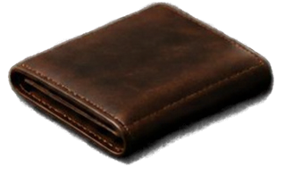


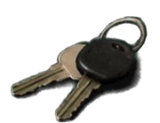
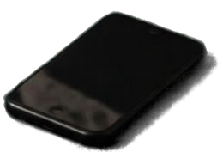

Trust. Recover. Reuse.
Faster reunions,
less waste
Built for colleges, offices, events,
and public venues
Privacy first.
We verify before
every handover
FoundIt turns everyday
loss into community impact
SIH26219

